Slide 1
Lecture 17
Understanding Harmony in the Society

Slide 2
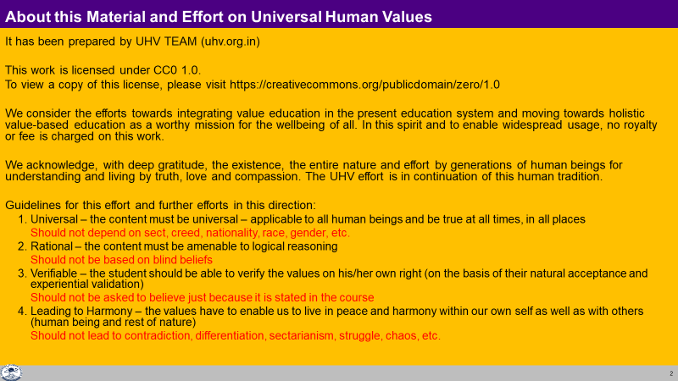

Slide 3
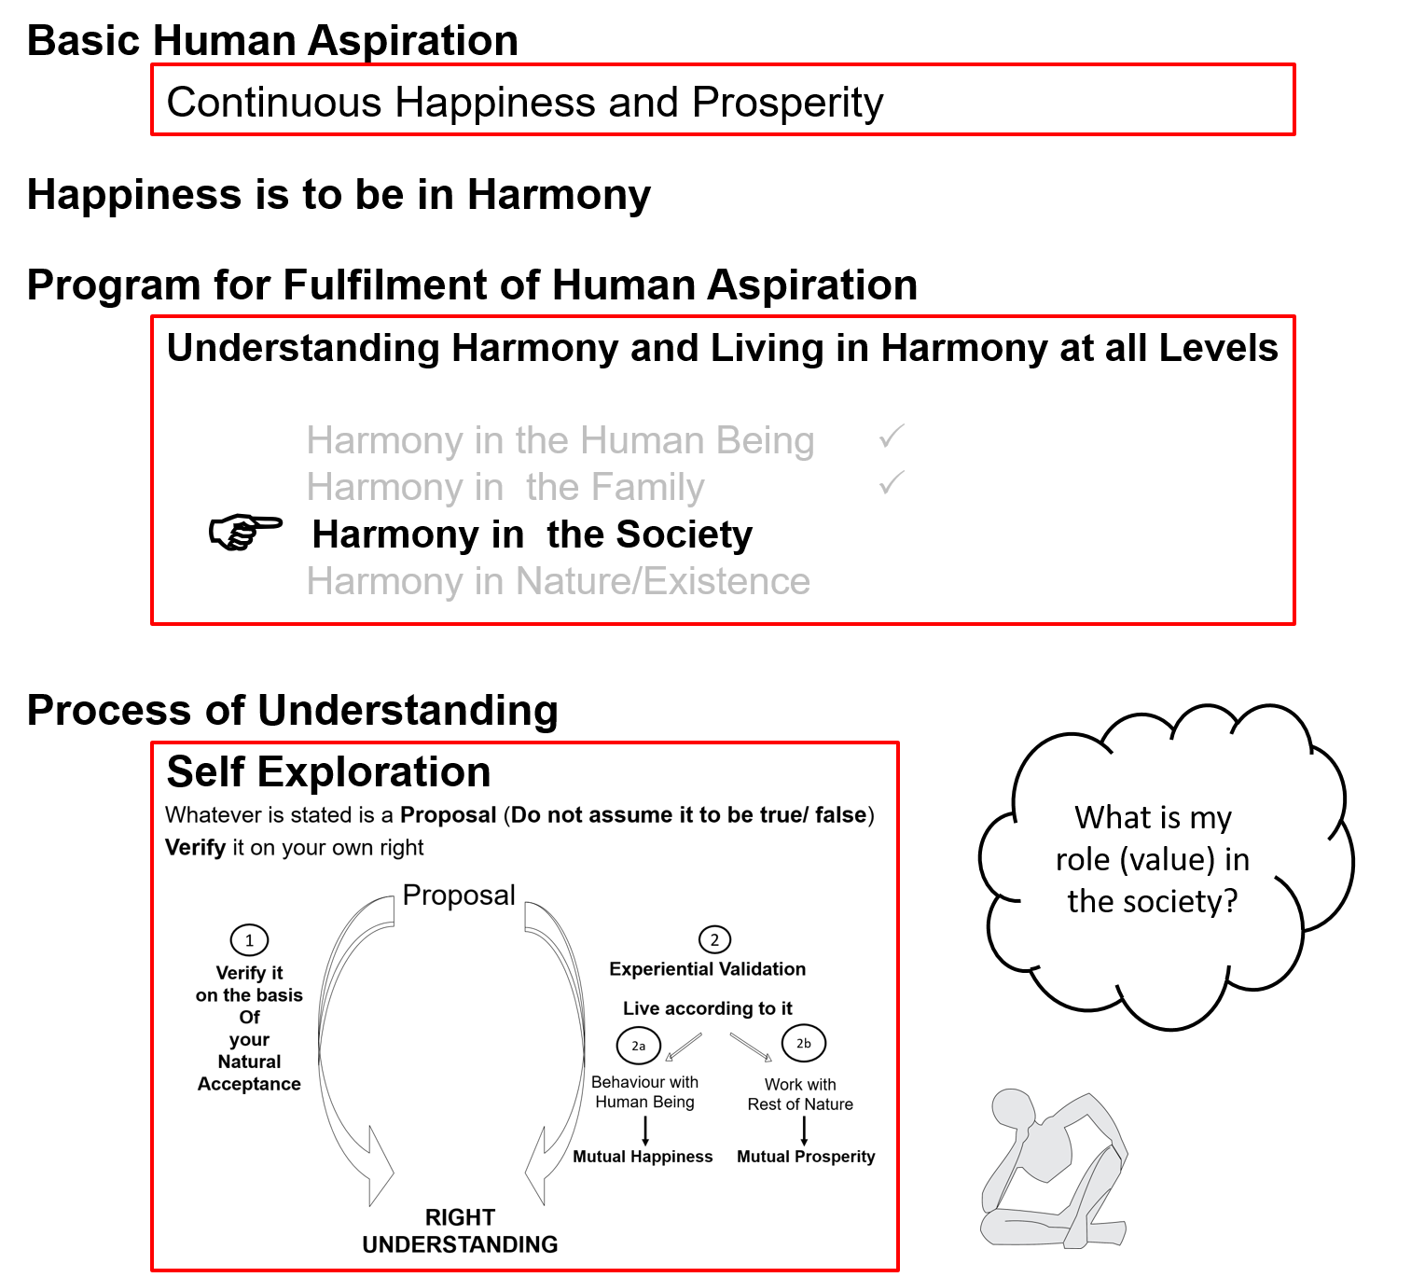
Notes:
This has been covered many times, so take only a minute or two on this

Slide 4

What is Society and Where are we today?
Families living together, in a relationship of mutual fulfillment
(common goal)
Society
People living together, but not in relationship of mutual fulfillment
(differing goals)
Crowd
People living separately, in opposition / struggle
(conflicting goals)
Battlefield
We will explore harmony in society –
The base of harmony in society is harmony in family
for which the base is harmony in human being
Notes:
Key point is that we will explore society = families living together, in a relationship of mutual fulfillment and making effort for a common human goal

Slide 5
Society
We saw that the family is the basic unit or building block of human organisation
The society is the next larger order
Society is composed of many families living together making collective effort for a common goal
We will explore a society that ensures living in harmony with the entire nature:
Goal of human being living in society (human goal)
The dimensions or systems required to achieve the human goal
Scope of the systems (in the next lecture)
Notes:
समाज = मानव का सम्पूर्ण प्रकृति के साथ परस्पर-पूरकता पूर्वक जीने का स्वरुप
सार्वभौम मानवीय व्यवस्था का स्वरुप
मानव का प्रकृति की चारो अवस्थाओं के साथ परस्पर-पूरकता पूर्वक जीने का स्वरुप
कार्यक्रम-
शिक्षा संस्कार- जीवन में ज्ञान, समाधान सुनिश्चित करने हेतु
स्वास्थ्य संयम- शरीर के स्वास्थ्य & तदनुकुल आहार,विहार की समझ हेतु
उत्पादन-कार्य शरीर के पोषण, संरक्षण (स्वास्थ्य के अर्थ में) एवं
विनिमय-कोष सदुपयोग के लिये आवश्यक सुविधा की प्राप्ति हेतु
न्याय-सुरक्षा- मानव का प्रकृति समग्र के साथ पूरकता के निर्वाह हेतु
अतः- मन (जीवन), तन (शरीर), धन (सुविधा) का संवर्धन, संरक्षण, सदुपयोग

Slide 6
Harmony in the Society (lekt esa O;oLFkk)
Human Goal (ekuo y{;)
Are all 4 required, desirable or we can leave something out?
If all 4 are achieved, would anything else be required?
Are we working for all 4? In the family? In the society?
What would be the sequence and priority of effort on these goals?
Right Understanding & Right Feeling
Prosperity
Fearlessness
(Trust)
Co-Existence
(mutual fulfilment)
Happiness
In Every Individual
In Every Family
In Society
In Nature/ Existence
1
2
3
4
Notes:
Key points
Proposal of these 4 human goals – are these naturally acceptable, then ask the other questions
Ask the last qs. about the sequence in which these goals can be fulfilled – spend some time on the sequence

Slide 7
Current State – Have we understood our Goal?
Human Goal (ekuo y{;)
Gross Misunderstanding (vk/kkjHkwr Hkze)
Right Understanding & Right Feeling
Prosperity
Fearlessness
(Trust)
Co-Existence
(mutual fulfilment)
Happiness
In Every Individual
In Every Family
In Society
In Nature/ Existence
Assumptions (eg. Money is everything)
Accumulation
By Any Means
Domination ,
Exploitation, Fear
Mastery &
Exploitation
In Every Individual
In few Individuals
In Society
Over Nature
Obsession for Consumption Hkksx mUekn
“ for Profit ykHk mUekn
“ for Sensual Pleasure dke mUekn
Terrorism
War
Resource Depletion
Pollution
Notes:
Key point is that most of the problems we see around us are due to lack of clarity of human goal.
We don’t have to harp on the specific problems - Let participants explore the current state.
Don’t spend too much time on this slide

Slide 8

"Limits to Growth“, The Club of Rome, 1972
The Club of Rome publishes "Limits to Growth". The report is extremely controversial because it predicts dire consequences if there is not a slowdown of "growth" (throughput of raw materials from nature) in 50 years (by 2022):
Environmental breakdown
Breakdown of human relationship – wars
Mental breakdown
By 2016
2016 was hottest year in India’s recorded history (>51 degrees C), global atmospheric CO2 > 400PPM, way beyond stable norm of 300PPM
Over 50% tax money spent globally on preparing for war
WHO statistics show increasing obesity (>30%), depression (>10%) & suicide rates (>0.1%) in developed countries
Notes:
This is a passing reference. Dont dwell on this slide

Slide 9
Problems
Human being +
Human-human relationship
Obesity, other diseases
Depression
Alcoholism, drug abuse
Suicide
Population
Breakdown of family system
Divorce
Societal breakdown
Terrorism
War
Human-rest of nature relationship
Atmospheric carbon (CO2…)
Soil fertility
Water insecurity
Seed for profit
Food insecurity
Breed for profit
Genetic manipulation for profit
Global warming
Climate change

Slide 10
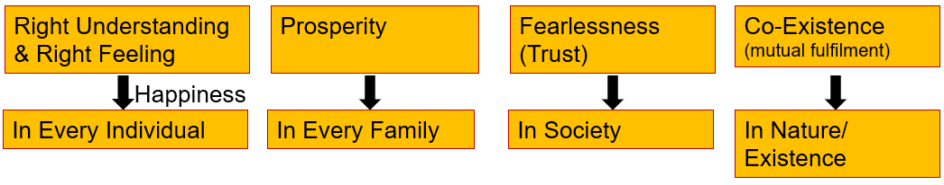

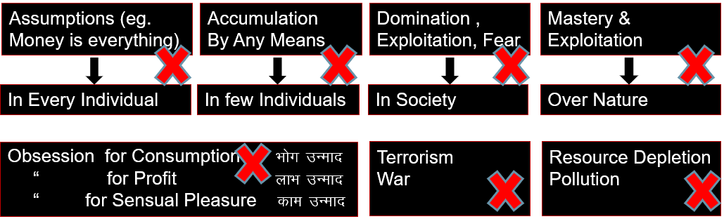
Self Reflection
How much of your imagination is about these naturally acceptable human goals, how to achieve them; and slowly transition from present society to a human society?
And how much of your imagination is about the problems in the present society and how to manage in it?
Natural Acceptance
INTENTION
3
Preconditioning
ekU;rk
1
COMPETENCE
What You Are
2
Sensation
Lakosnuk
Notes:
Don’t dwell on this slide

Slide 11
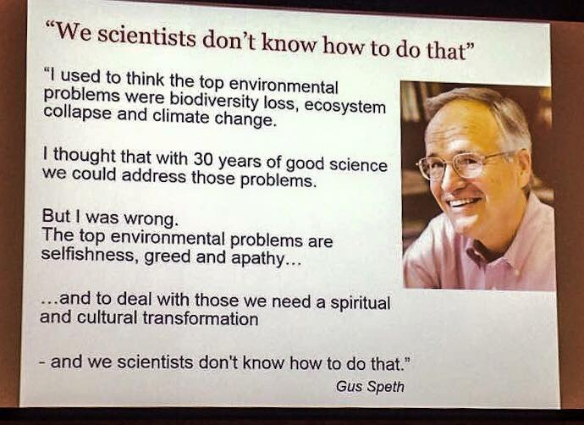

Slide 12
Harmony in the Society (lekt esa O;oLFkk)
Human Goal (ekuo y{;)
Human Order ¼ekuoh; O;oLFkk½
Systems / Dimensions ¼vk;ke½
  1. Education – Sanskar - f”k{kk laLdkj
  2. Health – Self-regulation - LokLF; la;e
  3. Production – Work - mRiknu dk;Z
  4. Justice – Preservation - U;k; lqj{kk
  5. Exchange – Storage - fofue; dks’k
Right Understanding & Right Feeling
Prosperity
Fearlessness
(Trust)
Co-Existence
(mutual fulfilment)
Happiness
In Every Individual
In Every Family
In Society
In Nature/ Existence
1
2
3
4
Notes:
Introduce the 5 sets of systems or dimensions briefly – we will detail them as we proceed

Slide 13
Harmony in the Society (lekt esa O;oLFkk)
Human Goal (ekuo y{;)
Human Order ¼ekuoh; O;oLFkk½
Systems / Dimensions ¼vk;ke½
  1. Education – Sanskar
  2. Health – Self-regulation
  3. Production – Work
  4. Justice – Preservation
  5. Exchange – Storage
Right Understanding & Right Feeling
Prosperity
Fearlessness
(Trust)
Co-Existence
(mutual fulfilment)
1
Happiness
2
3
4
In Every Individual
In Every Family
In Society
In Nature/ Existence
1
2
3
4
1
2
4
3
4
2
3
Notes:
Connect the specific goal with each system or dimension. May include sone detail of each dimension, but we will elaborate them further as we proceed

Slide 14
Harmony in the Society (lekt esa O;oLFkk)
Human Goal
Human Order ¼ekuoh; O;oLFkk½
Systems / Dimensions ¼vk;ke½
  1. Education – Sanskar
  2. Health – Self-regulation
  3. Production – Work
  4. Justice – Preservation
  5. Exchange – Storage
Right Understanding & Right Feeling
Prosperity
Fearlessness
(Trust)
Co-Existence
(mutual fulfilment)
1
Happiness
In Every Individual
In Every Family
In Society
In Nature/ Existence
1
2
3
4
1a. Education – To develop the right understanding of the harmony at all levels of our being – from self to the entire existence (individual, family, society, nature/existence)
1b. Sanskar – The commitment, preparation and practice of living in harmony. Preparation includes learning the skills and technology for living in harmony at all levels – from self to the entire existence (individual, family, society, nature/existence)
1

Slide 15
Education-Sanskar
Education = Developing Right Understanding
Sanskar = Commitment/ Preparation/ Practice for Right Living
Preparation includes Learning Right Skills and Technology and their Practice
Development of the competence to live with Definite Human Conduct
Discipline to Self-Discipline
Right understanding, i.e. wisdom or clarity about what to do as a human being – in oneself, family, society, nature…
Right feeling – the capacity to live in relationship with the other human beings – in family, society…
Right skills for prosperity, i.e.
    The capacity to identify the need of physical facility
    The skills & practice for sustainable production of more than what is required (by way of labour, using cyclic, mutually enriching process)
    The feeling of prosperity

Slide 16
Process of Developent – In an environment of Relationship
Assuming ekuuk
Knowing
tkuuk
Imitate vuqlj.k
Family
ifjokj
School
fo|ky;
University
fo”o&fo|ky;
Society
lekt
Follow vuqdj.k
Next Generation
Obedience/Discipline
vkKkikyu@vuq'kklu
Relationship
laca/k
Right
lgh
Self-verif
Tkk¡p
Self Discipline (10…)
Lo&vuq'kklu
Self-confidence
vkRefo”okl
Next generation is likely to be more developed…
In harmony within
In harmony with family
In harmony with society
In harmony with nature/existence
Notes:
अनुसरण = पीछे पीछे चलना, जैसे भाषा सीखना
अनुकरण = अपने से भी कुछ करने में जोड़ना, जैसे साइकिल चलाना सीखना

Slide 17
Process of Developent – In an environment of Domination
Assuming ekuuk
Imitate vuqlj.k
Family
ifjokj
School
fo|ky;
University
fo”o&fo|ky;
Society
lekt
Follow vuqdj.k
Next Generation
Obedience/Discipline
vkKkikyu@vuq'kklu
Domination
'kklu
Self-verif
Tkk¡p
Wrong
xyr
Arbitrariness euekuh
Next generation may be less developed
In more contradiction within
In more opposition with family
More struggle in society
More conflict with nature/ existence
Opposition nz®g
Revolt fonz®g (~teenage)
Struggle laÄ‘kZ
War ;q)

Slide 18
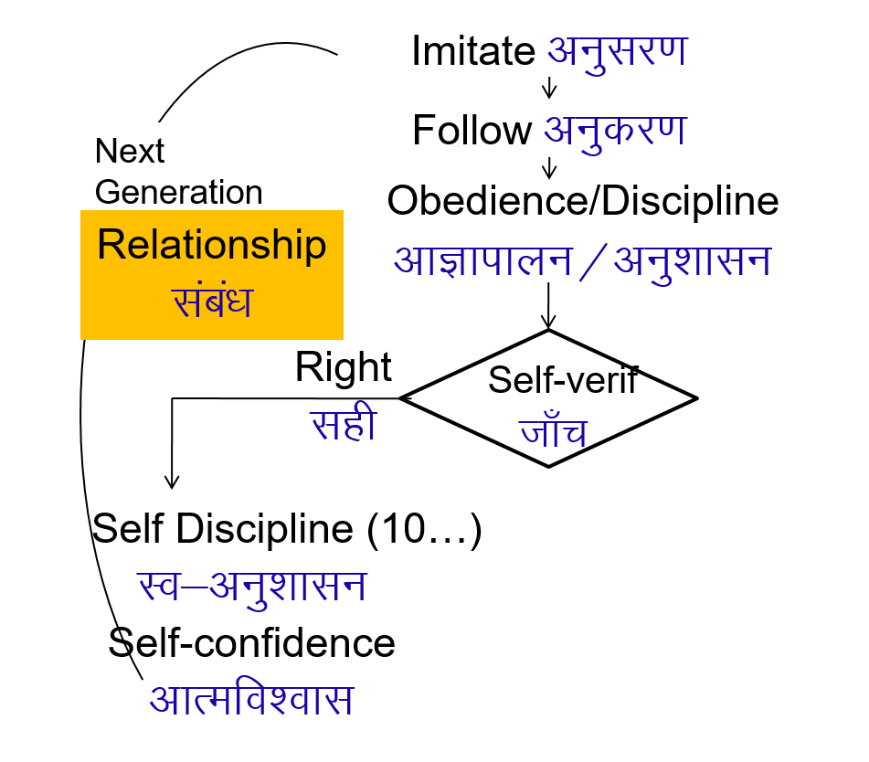
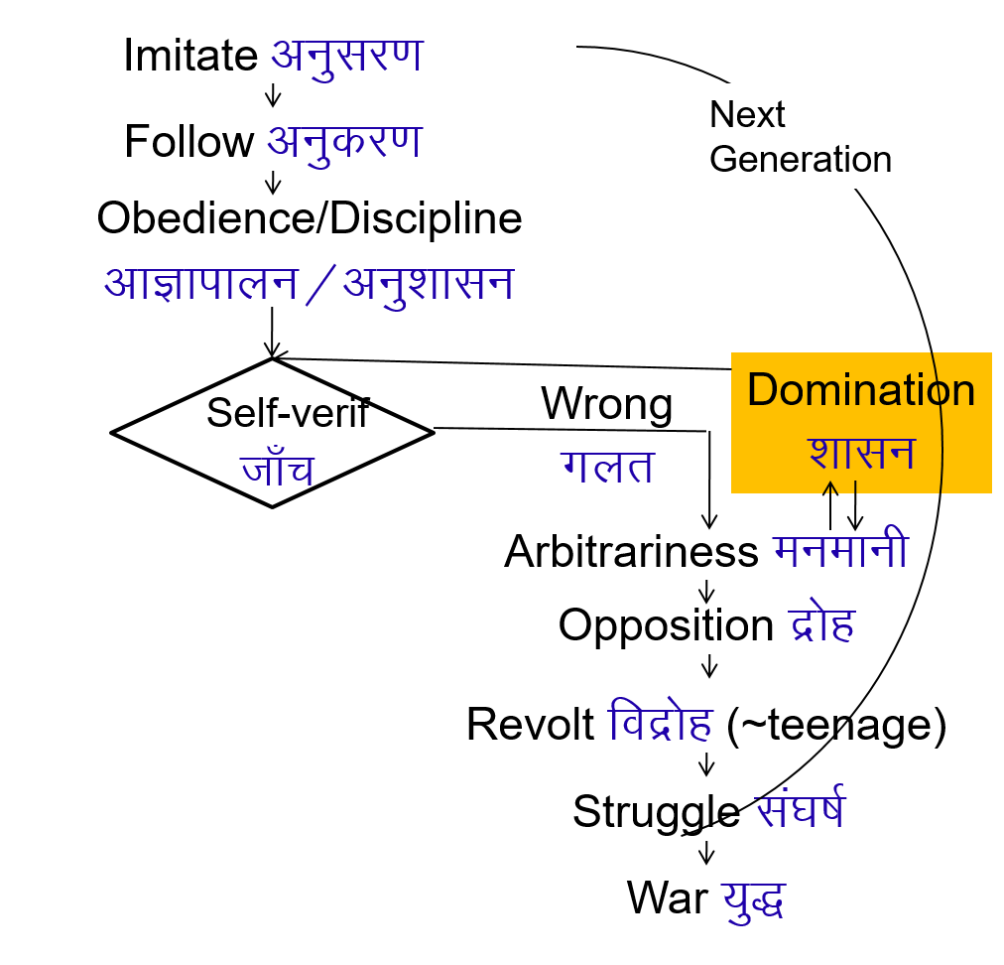

आज हम कहाँ हैं? कहाँ होना चाहते हैं? Where are we today? Where do we want to be?
Small Children
Youth,
Adults
In an environment of Relationship
With parents and teachers having
right understanding and right feeling
In an environment of Domination
With parents and teachers lacking
right understanding and right feeling

Slide 19
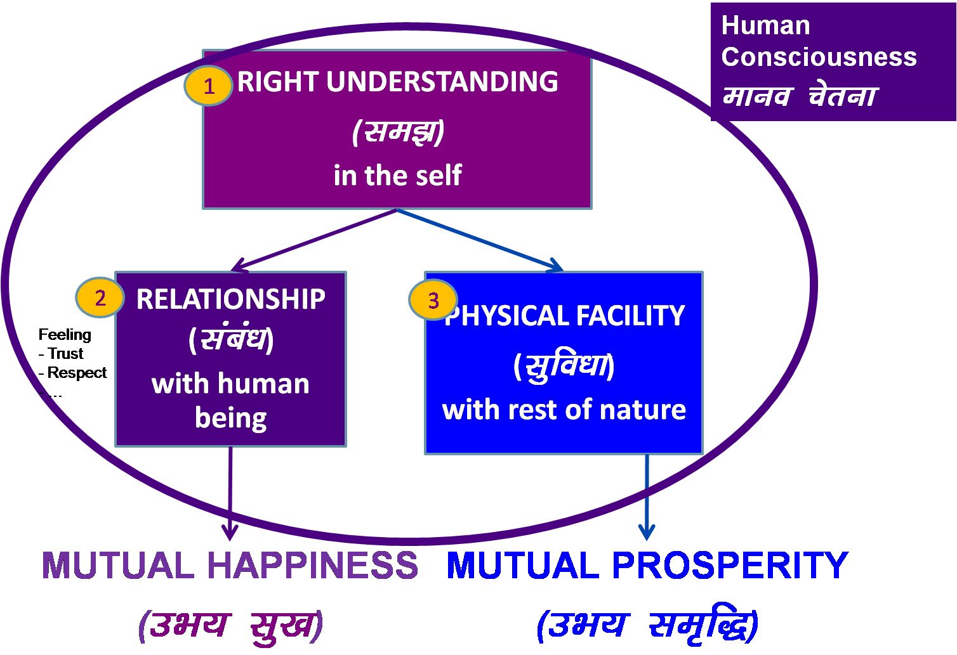
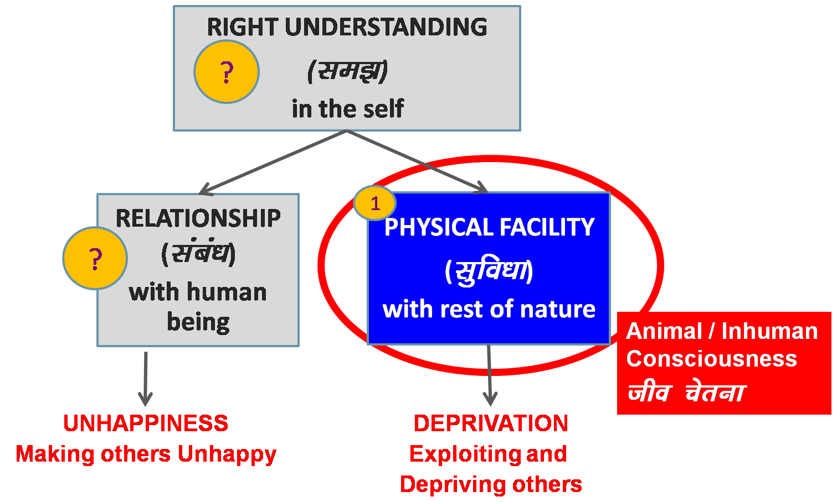
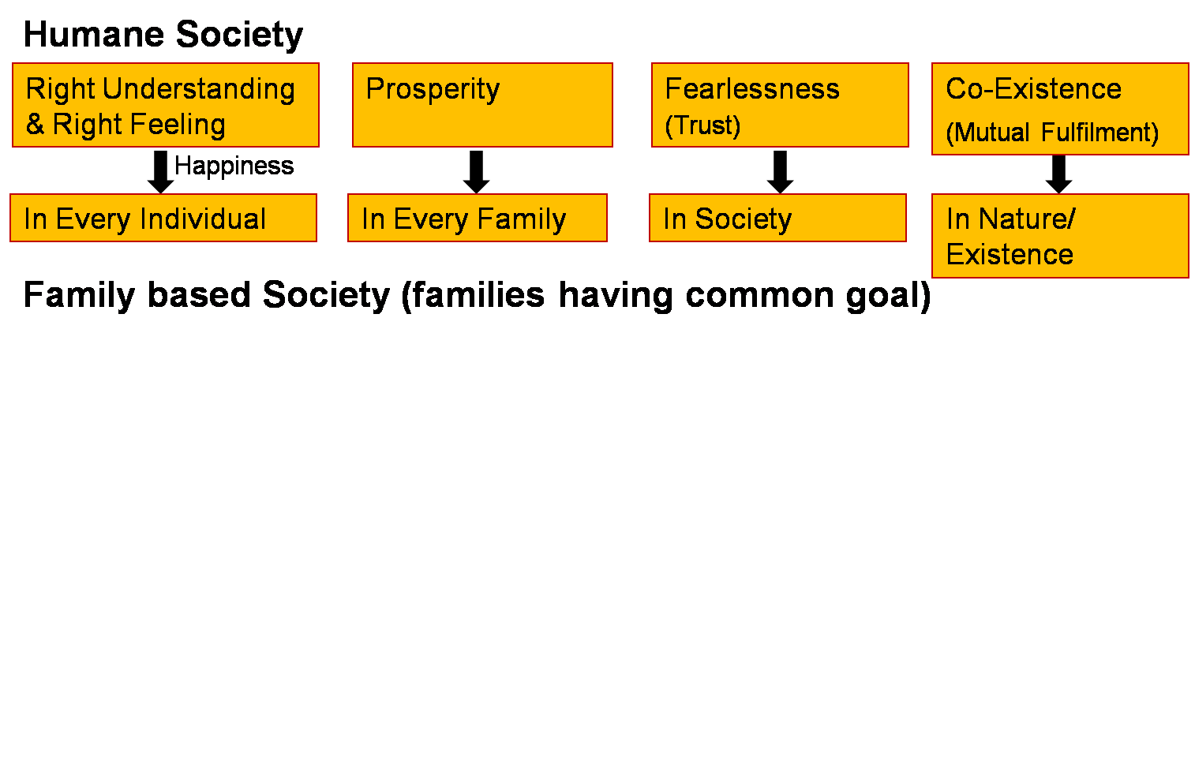
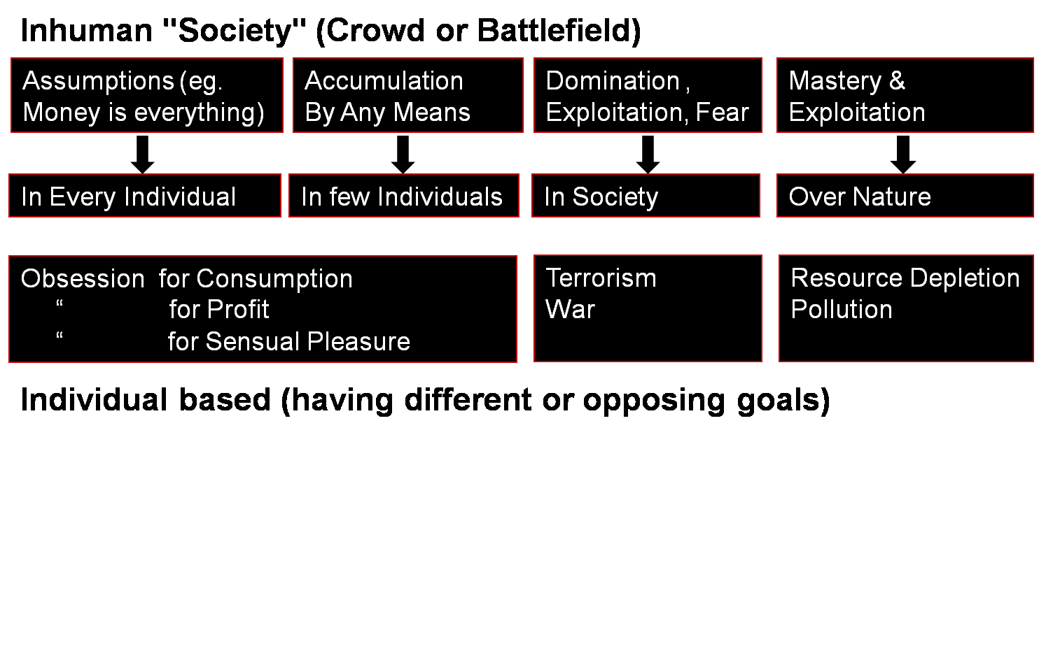
Human Education
Human Consciousness
Human Values
Human Conduct
Humane Society
Overall Transformation
Personal Transformation
Societal Transformation
Transformation& Progress
laØe.k&fodkl

Slide 20
Harmony in the Society (lekt esa O;oLFkk)
Human Goal
Human Order ¼ekuoh; O;oLFkk½
Systems / Dimensions ¼vk;ke½
  1. Education – Sanskar
  2. Health – Self-regulation
  3. Production – Work
  4. Justice – Preservation
  5. Exchange – Storage
Right Understanding & Right Feeling
Prosperity
Fearlessness
(Trust)
Co-Existence
(mutual fulfilment)
Happiness
2
4
In Every Individual
In Every Family
In Society
In Nature/ Existence
1
2
3
4
2b. Self-regulation – Feeling of responsibility for Nurturing, Protection and Right Utilization of the Body
2a. Health (Swasthya) –
  Body acts according to Self (I)
  Parts of the body are in harmony (in order)
→ Recognising What is Needed as Physical Facility
2
4

Slide 21
Program for Health-Self Regulation
(A) For Staying Healthy
1a
  1 Intake and Routine (Lifestyle)
  2 Labour and Exercise
  3 Postures for regulating internal & external body organs and
  Regulated Breathing
  4 Medicine and Treatment
1
1b
2
(B) For bringing body back to harmony from temporary disharmony
3
(C) Dependence on drug / machine to perform a body function

Slide 22
Harmony in the Society (lekt esa O;oLFkk)
Human Goal
Human Order ¼ekuoh; O;oLFkk½
Systems / Dimensions ¼vk;ke½
  1. Education – Sanskar
  2. Health – Self-regulation
  3. Production – Work
  4. Justice – Preservation
  5. Exchange – Storage
Right Understanding & Right Feeling
Prosperity
Fearlessness
(Trust)
Co-Existence
(mutual fulfilment)
Happiness
2
4
In Every Individual
In Every Family
In Society
In Nature/ Existence
1
2
3
4
2
4
3b. Work: The labour a human being does on the rest of nature
3a. Production: The physical facility obtained out of work

Slide 23
Harmony in the Society (lekt esa O;oLFkk)
Human Goal
Human Order ¼ekuoh; O;oLFkk½
Systems / Dimensions ¼vk;ke½
  1. Education – Sanskar
  2. Health – Self-regulation
  3. Production – Work
  4. Justice – Preservation
  5. Exchange – Storage
Right Understanding & Right Feeling
Prosperity
Fearlessness
(Trust)
Co-Existence
(mutual fulfilment)
Happiness
2
4
In Every Individual
In Every Family
In Society
In Nature/ Existence
1
2
3
4
1. What to Produce?
Required Physical Facility (necessary for nurturing, Protection & right utilisation of body)
2
4
2. How to Produce?
Mutually Enriching, Cyclic Process (Eco-Friendly)
Ensuring Justice (People-Friendly)

Slide 24
Mutually Enriching, Cyclic Process (Avartansheel Process)
Cyclic
Every Unit in the Process is Enriched
This mutually enriching, cyclic process is already going on in Nature. We do not have to create it
Plants...
Soil, Water,
Air...

Slide 25
Mutually Enriching, Cyclic Process (Avartansheel Process)
Cyclic
Every Unit in the Process is Enriched
This mutually enriching, cyclic process is already going on in Nature. We do not have to create it
Plants...
Soil, Water,
Air...
Animals, Birds

Slide 26
Resource Depletion & Pollution
Resource Depletion – The resource is used at a rate which is faster than the rate at which it is produced in Nature
lalk/ku vHkko & mRiknu esa iz;qDr laalk/ku dh xfr] mlds izd`fr esa iSnk gksus dh xfr ls T;knk gS
Pollution – The product is such that
  It does not return to the cycle in Nature or
  It is produced at a rate that is faster than the rate at which it can return to the cycle in Nature
iznw’k.k & mRiknu ,slk gS fd
  1- mRikfnr oLrq pØ esa okil ugha vkrh ;k
  2- mRiknu dh xfr izkd`frd pØz esa okil tkus dh xfr ls T;knk gS

Slide 27
Mutually Enriching, Cyclic Process (Avartansheel Process)
Cyclic
Every Unit in the Process is Enriched
  We, human beings, have to understand the mutual fulfilment in nature & to live accordingly
  i.e. To update the man-made processes to be cyclic and mutually enriching
Plants...
Soil, Water,
Air...
Animals & Birds
?
?
√
?
√
√
Human
Beings

Slide 28
Mutually Enriching, Cyclic Process (Avartansheel Process)
Cyclic
Every Unit in the Process is Enriched
  We, human beings, have to understand the mutual fulfilment in nature & to live accordingly
  i.e. To update the man-made processes to be cyclic and mutually enriching
Plants...
Soil, Water,
Air...
Animals & Birds
?
?
?
Human
Beings

Slide 29
Localise Lons'kh Globalise lkoZHkkSfed
Physical Facility (Intake, Clothes, House…)
lqfo/kk ¼vkgkj] diM+k] vkokl--- ½
Needs of the Body
“kjhj dh vko';drk,a
Right Understanding & Right Feeling
Mindset – of living in a relationship of mutual fulfillment, globally
lgh le>] lgh Hkko ¼Kku] lek/kku½
Needs of the Self (I)
eSa dh vko';drk,a

Slide 30
Requirement (for Self Sufficiency) Availability
Family of 10
2 acres of land
40 man hrs or work / day
Sufficient to produce what is required for nurturing (food…), protection of body (clothes, shelter, medicine…)
and right utilisation of body (instruments, equipments…)
4 full grown trees – wood for 1 person
90% production in family
10% by exchange / shared by larger order
In India, land availability
2.73 acres of agricultural land for every 10 persons
Total land = 32,87,590 sq km
Forest 21.6%
Agricultural 46.2%
Fallow 8.6%
Built-up/Other 23.6%
Total population = 137 cr
1 sq km = 247.105 acre

Slide 31
Abundance of Natural Fresh Water Availability
India
3,287,590 km²
890 mm average rainfall
Total annual rainfall
2,925 cubic km
Total annual human water use
230 cubic km (urban + rural)
Water Storage
  Forest (tree roots) (max%)
  Glaciers (small%)
  Bauxite mountains (min%)
  Bogs, underground aquifers (433,000 cubic km)
  Lakes, ponds…
  Forests
Natural distribution of water
  Rain
  Rivers & Streams overground (also distributes silt, fish…)
  Rivers & Streams underground

Slide 32
Water Status – Mismanagement
India
3,287,590 km²
890 mm average rainfall
(has become erratic)
Total annual rainfall
2,925 cubic km (59% in 2014)
Total annual human water consumption
230 cubic km (urban + rural)
  (increasing indiscriminate use in urban areas, dumping of waste in rivers, ground..., chemical farming, heavy machinery, reduced bio-diversity...)
Water Storage
  Forests (deforestation)
  Glaciers (melting rapidly)
  Areas with bauxite (mining)
  Bogs, underground aquifers (433,000 cubic km) (30% dry)
  Lakes, ponds… (filled up with soil, waste…)
Natural distribution of water
  Rain (disturbed)
  Rivers (both over & under ground disturbed)
Unnatural storage & distribution of water
  Dams
  Canals

Slide 33
Prosperity of Human Being
Prosperity = Feeling of having more than required physical facility
2 1
  Identification of required physical facility (including the required quantity) – with right understanding
  Ensuring availability/ production of more than required physical facility – with right skills
A prosperous person thinks of right utilisation, nurturing the other
“ deprived “ “ “ accumulation, exploiting “ “

Slide 34
Harmony in the Society (lekt esa O;oLFkk)
Human Goal
Human Order ¼ekuoh; O;oLFkk½
Systems / Dimensions ¼vk;ke½
  1. Education – Sanskar
  2. Health – Self-regulation
  3. Production – Work
  4. Justice – Preservation
  5. Exchange – Storage
Right Understanding & Right Feeling
Prosperity
Fearlessness
(Trust)
Co-Existence
(mutual fulfilment)
Happiness
3
In Every Individual
In Every Family
In Society
In Nature/ Existence
1
2
3
4
4a. Justice – Recognition of Human-Human Relationship, its Fulfillment & Evaluation leading to Mutual Happiness
3
Notes:
* U;k; lqj{kk& f}rh; egRoiw.kZ vk;ke
U;k;¾ekuo&ekuo laca/k dh igpku] fuokZg]mHk; lq[k
lqj{kk¾ekuo&”ks’k izd`fr laca/k dh igpku] fuokZg]mHk; le`f)
U;k; lqj{kk dh ftEesnkjh gj O;fDr dh gS] ifjokj dh gS] lekt dh gS vkSj varr% jkT; dh gSA
lekt o jkT; esa U;k; lqj{kk dks lqfuf”pr djus dh ftEesnkjh “kklu&iz”kklu dh gSA
jkT; esa vxj U;k;] lqj{kk dh lqfuf”prrk u gks ik;] vogsyuk gks] foijhr gks rks
ml vU;k;] vlqj{kk dks jksdus dh ftEesnkjh U;k;ikfydk o iqfyl dh gSA
U;k; lqj{kk dks lqfuf”pr djus esa “kklu&iz”kklu dk lg;ksx djus dh ftEesnkjh iqfyl dh gSA
U;k; D;k gS\&bls le>uk vko”;d gSA&laca/k] Hkko ewY;&fo”okl] lEeku
lqj{kk D;k gS\ &ijLijiwjdrk
D;k gesa U;k; dh Li’Vrk gS\
D;k ge U;k;iwoZd th jgs gS &Lo;a esa lgh Hkko gS
ifjokj esa lgh Hkko gS] mldk fuokZg dj mHk; lq[k gks jgk gS
fe=ksa esa] lgdfeZ;ksa esa lgh Hkko gS] mldk fuokZg dj mHk; lq[k gks jgk gS
&lekt esa U;k;iwoZd th ik jgs gSa\
&lekt esa vU;k; dks jksd ik jgs gSa\
;gh lc iz”u lqj{kk dks ysdj Hkh gSaA

Slide 35
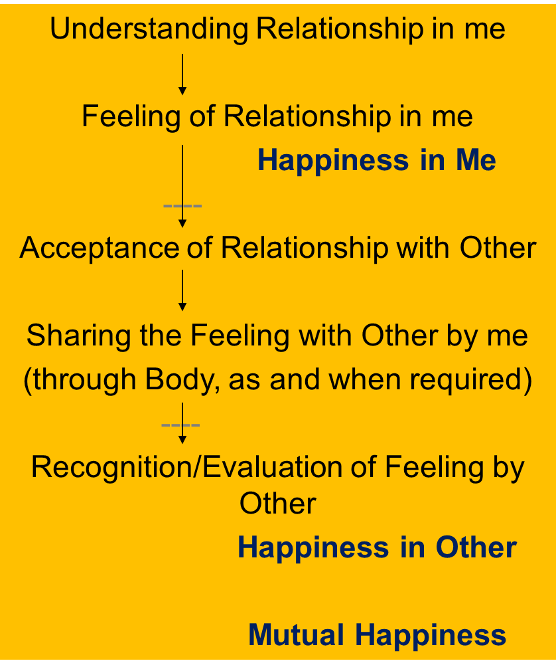
Harmony in Family – Justice, From Family to World Family (Undivided Society)
Relationship is – between one self (I₁) and other self (I₂)
There are feelings in relationship – in one self (I₁) for other self (I₂)
These feelings can be recognized – they are definite (9 Feelings)
Their fulfilment, evaluation leads to mutual happiness
Feelings in relationship:
Justice = Recognition, Fulfillment & Evaluation of
Human-Human Relationship, leading to Mutual Happiness
Justice → from Family to World Family
→ Undivided Society ¼v[k.M lekt½
1- Trust fo”okl FOUNDATION VALUE
2- Respect lEeku
3- Affection Lusg
4- Care eerk
5- Guidance okRlY;
6- Reverence J)k
7- Glory xkSjo
8- Gratitude —rKrk
9- Love izse COMPLETE VALUE

Slide 36
Harmony in the Society (lekt esa O;oLFkk)
Human Goal
Human Order ¼ekuoh; O;oLFkk½
Systems / Dimensions ¼vk;ke½
  1. Education – Sanskar
  2. Health – Self-regulation
  3. Production – Work
  4. Justice – Preservation
  5. Exchange – Storage
Right Understanding & Right Feeling
Prosperity
Fearlessness
(Trust)
Co-Existence
(mutual fulfilment)
Happiness
4
In Every Individual
In Every Family
In Society
In Nature/ Existence
1
2
3
4
4b. Preservation – Recognition of Human-Rest of Nature Relationship, its Fulfillment & Evaluation leading to Mutual Prosperity or Mutual Enrichment
Prosperity of Human Being
Enrichment, Protection & Right Utilisation of rest of Nature
4

Slide 37
Preservation of Rest of Nature
What is fundamental?
Enrichment, Protection or Right Utilisation of Nature
– Right Utilisation of Nature
e.g.,
Wood of 4 full grown trees is enough for one person's needs from birth to death, including the pyre wood
How many trees can you plant in your lifetime?
– At least 10 trees?
– Or even one tree on every birthday, so 60-70 trees?
One Prof. Parmeshwara Rao of Emanchally village has planted 5000 trees in each of the 100 villages near Emanchally, AP. This has enriched nature

Slide 38
Harmony in the Society (lekt esa O;oLFkk)
Human Goal
Human Order ¼ekuoh; O;oLFkk½
Systems / Dimensions ¼vk;ke½
  1. Education – Sanskar
  2. Health – Self-regulation
  3. Production – Work
  4. Justice – Preservation
  5. Exchange – Storage
Right Understanding & Right Feeling
Prosperity
Fearlessness
(Trust)
Co-Existence
(mutual fulfilment)
Happiness
2
3
In Every Individual
In Every Family
In Society
In Nature/ Existence
1
2
3
4
5a. Exchange – of physical facility with a view of mutual fulfillment
(not with obsession for profit / of exploitation)
5b. Storage – of physical facility with a view of mutual fulfillment
(not with obsession for profit / of accumulation)
2
3
Notes:
Can mention 2 types of economics
take-take economics (I want to maximise my returns, you also want to maximise your return) – both are opposed to each other, in competition with each other
Give-give economics (I want to give to you, like a mother to a child;, you also want to give to me, like a child to the mother) – both feel related to the other
Can give example for give-give economics: jajmani system, where the whole village was seen as a joint family and PF was simply distributed, not even exchanged

Slide 39
Harmony in the Society (lekt esa O;oLFkk)
Human Goal (ekuo y{;)
Human Order ¼ekuoh; O;oLFkk½
Systems / Dimensions ¼vk;ke½
  1. Education – Sanskar
  2. Health – Self-regulation
  3. Production – Work
  4. Justice – Preservation
  5. Exchange – Storage
Right Understanding & Right Feeling
Prosperity
Fearlessness
(Trust)
Co-Existence
(mutual fulfilment)
1
Happiness
2
3
4
In Every Individual
In Every Family
In Society
In Nature/ Existence
1
2
3
4
1
2
4
3
4
2
3

Slide 40
Sum Up
A society is composed of families living together, in a relationship of mutual fulfillment. They have a common goal, which is:
    Right understanding & right feeling (happiness) in every individual
    Prosperity in every family
    Fearlessness (trust) in society
    Co-existence (mutual fulfilment) in nature/existence
The family is the basic unit in society, i.e. society is composed of family, group of families, village family, group of village families, town family… and so on, where every individual is responsible or self-disciplined and self motivated by common values, participating in the larger order toward a common human goal
Through the participation of every family in the society, in the 5 dimensions or social systems, the common human goal is fulfilled for all
    – from family order to world family order
    – generation after generation
[the current civilization is largely based on the assumption that human being = body, happiness is derived primarily from sensual pleasure & feeling from other; and hence accumulation of physical facility, domination and exploitation is at the core of the socio-economic systems]
1. Education – Sanskar
2. Health – Self-regulation
3. Production – Work
4. Justice – Preservation
5. Exchange – Storage

Slide 41
Harmony in the Society: Order, from Family Order to World Family Order – Universal Human Order
Human Goal
(ekuo y{;)
Human Order ¼ekuoh; O;oLFkk½
Systems / Dimensions ¼vk;ke½
  1. Education – Sanskar
  2. Health – Self-regulation
  3. Production – Work
  4. Justice – Preservation
  5. Exchange – Storage
Scope – From Family Order to World Family Order (Universal Human Order)
Family – Family cluster – Village – Village cluster/city ... Nation ... World Family
Order Order Order Order Order Order
~10¹ ~10² ~10¹⁰
Right Understanding & Right Feeling
Prosperity
Fearlessness
(Trust)
Co-Existence
(mutual fulfilment)
Happiness
In Every Individual
In Every Family
In Society
In Nature/ Existence

Slide 42
Self Reflection

Slide 43
Assignment for Today
What is the common goal of the organization you belong to? …your family? How does it map to the Human Goal?
Is the goal and how to achieve it discussed periodically?
How can you, your family and your organization contribute to ensuring right understanding and right feeling in the neighborhood of the institution?

Slide 44
What is Desirable and Where are we today?
Families living together, in a relationship of mutual fulfillment
(common goal)
Society
People living together, but not in relationship of mutual fulfillment
(differing goals)
Crowd
People living separately, in opposition / struggle
(conflicting goals)
Battlefield

Slide 45
Self Reflection
What is the common goal of the organization you belong to? How does it map to the Human Goal?
How can you and your organization contribute for ensuring right understanding and right feeling in the neighborhood of the institution?

Slide 46
Key Points
Lecture 17: Understanding Harmony in the Society

Slide 48
Harmony in the Society (lekt esa O;oLFkk)
Human Goal (ekuo y{;)
Human Order ¼ekuoh; O;oLFkk½
Systems / Dimensions ¼vk;ke½
  1. Education – Sanskar
  2. Health – Self-regulation
  3. Production – Work
  4. Justice – Preservation
  5. Exchange – Storage
Right Understanding & Right Feeling
Prosperity
Fearlessness
(Trust)
Co-Existence
(mutual fulfilment)
1
Happiness
2
3
4
In Every Individual
In Every Family
In Society
In Nature/ Existence
1
2
3
4
1
2
4
3
4
2
3

Slide 49
Sum Up
A society is composed of families living together, in a relationship of mutual fulfillment. They have a common goal, which is:
    Right understanding & right feeling (happiness) in every individual
    Prosperity in every family
    Fearlessness (trust) in society
    Co-existence (mutual fulfilment) in nature/existence
The family is the basic unit in society, i.e. society is composed of family, group of families, village family, group of village families, town family… and so on, where every individual is responsible or self-disciplined and self motivated by common values, participating in the larger order toward a common human goal
Through the participation of every family in the society, in the 5 dimensions or social systems, the common human goal is fulfilled for all
    – from family order to world family order
    – generation after generation
[the current civilization is largely based on the assumption that human being = body, happiness is derived primarily from sensual pleasure & feeling from other; and hence accumulation of physical facility, domination and exploitation is at the core of the socio-economic systems]
1. Education – Sanskar
2. Health – Self-regulation
3. Production – Work
4. Justice – Preservation
5. Exchange – Storage

Slide 50
FAQs for Lecture 17
Understanding Harmony in the Society

Slide 51
Question(s): Response
It looks very good to hear such things. But it looks like a utopian society. Can we ever achieve such a society?
Are we talking about an ideal state of society here?
First of all we need to see our natural acceptance. Do we want a harmonious society or a disharmonious one? Secondly, once I have the clear vision of a harmonious society, my thought, behavior and work get self-organized on that basis, which ensures happiness and feeling of prosperity in me. Since it is the natural acceptance of every one, the time it will take does not matter. What matters is our program.
If such a society is imposed from outside, it becomes kind of utopian. But if it emerges from right understanding, it is natural.
We call something ideal when we do not have a definite program to achieve it. But given the program, it is the natural state.

Slide 52
Question(s): Response
Why are we calling it as human goals, and not social goals?
If you look at the goals, they give you a clear vision of participation of human being in the harmony in the society. Hence human goals.
Social goal would be to ensure undivided society and universal human order.

Slide 53
Question(s): Response
Can every person in the society have a common goal?
Why have we not included Health as one of the human goals?
The common goal is open to self-verification. You ask yourself and see what is your natural acceptance while living in a society. We have experimented with tens of thousands of people from all sorts of background, and every one shares the same goal. But it is again a proposal to explore. One can verify on one’s own right.
Health is a state of the body which is a natural outcome of self-regulation (a part of right understanding). Secondly, health has not continuity as body is a physio-chemical entity. Human goals are those which are continuous and universal.

Slide 54
Question(s): Response
Entertainment is an important part of life. Where would you place the entertainment industry in the society?
Every human being wants to have a life of happiness and prosperity in continuity. But it requires the competence to be developed in terms of right understanding and right feeling. Hence, while making a program for society, we need to first place the programs for happy and prosperous society.
But it will take time for every human being to attain the state of right understanding in completeness. In that duration, one can go for such programs which can help reduce the unhappiness or deprivation. Entertainment can be one of them. But we need to understand that such programs only help escape from unhappiness and do not ensure happiness in continuity.
We can also observe that when we make effort to live with mutual fulfilment with human being and the rest of nature, the need for such measures goes down.

Slide 55
Question(s): Response
Will there be fashion industry in a harmonious society?
Similar question for advertisement, publicity, etc.
A similar response as the one given for the previous question. To add to it
If the fashion industry is totally based on sensation without ensuring right utilization, we need to work out measures such that right utilization is also ensured.

Slide 56
Question(s): Response
How do we ensure harmony within the society, if the people surrounding us are doing wrong/disharmonious work intentionally? How can we teach/change such people in the society?
We discussed the feeling of trust. We saw that the intention of every human being is pure. Hence no one does anything wrong or disharmonious intentionally. This is one thing that needs to be clear. It’s only the lack of competence due to which such acts take place.
There is a good possibility that through value based education right from childhood, the right sanskar can be ensured in the child. And when such children grow into adults, they will develop a harmonious society.

Slide 57
Question(s): Response
If everybody has the feeling of self-regulation, people will be healthy, but there will be more unemployment of the healthcare professionals. How do we deal with that?
Similar question for lawyers, policemen, security guards, army,…
We need to understand the role of a human being in society. It needs to be to participate in the harmony in the society or at least reduce the level of disharmony. So the role of everyone gets transformed as there is transformation in the society. So in a harmonious society, a healthcare professional can work to ensure self-regulation in everyone through health education. And if still there is some occasional problem, he/she can work to remove the problem. Even today, it is happening.
A similar response holds true for lawyers, policemen, security guards, army,…

Slide 58
Question(s): Response
Today, there are so many industries in the society which do not add to harmony but generate employment as well as Govt. revenue. How do we plan for such industries?
First of all, we need to develop programs which help fulfill the human goals. Gradually, such industries will start transforming in terms of human goals.
Secondly, employment is not the core issue. Every human being is capable of producing more than required. And the resources are abundant in the nature. Due to lack of right understanding, the resources are not being rightly utilized. And mutual fulfillment is not ensured with human being and the rest of nature. If these two things are ensured, we will be able to address the needy areas in the society, and there will be enough employment.

Slide 59
Question(s): Response
Can you give some examples of sustainable, mutually enriching production systems?
When we talk about production of food, there are examples of natural farming, organic farming, sustainable farming methods etc. Even today, so many people are practicing it.
When we talk about health, we have examples of Ayurved, Naturopathy, Healing exercises etc.
Similarly, we can have examples for production of clothes, shelter, etc.

Slide 60
Question(s): Response
While going through courses of marketing, many a times it appears that we need to do injustice with the other to earn money. As a teacher or student, what can be our role?
Many a times, the inputs in professional courses contradict what we are studying in UHV. What to do then?
As mentioned earlier, there is abundance of physical facilities. Only the right understanding and right skills have to be developed. Once we are able to ensure this, harmonious ways of production and exchange will gradually evolve. Presently, our role is to share both the inputs and let the other verify.
We need to understand that there is a desired state and there is the current state. We need to work out the programs for transformation given the current state and our potential to transform.

Slide 61
Question(s): Response
Are we talking about going for barter system of exchange?
Are we talking about going to primitive practices of farming?
Are we talking about making mud houses?
etc.
What we are saying is that we need to ensure mutual happiness and mutual prosperity. Modes of fulfillment can be worked out depending on the current level of understanding of the people in the society. But we need to have a clear vision of a sustainable model of society.

Slide 62
Question(s): Response
For the victim of crime, justice is to punish the culprit. Why don’t you talk about punishment in the society?
Are justice and verdict the same thing or different things?
Justice is to ensure mutual happiness. Verdict is just to pronounce some decision.
Now when the crime has already taken place, we have a responsibility to:
  Give a message to the society that such acts are not to be continued
  To undo the loss to the victim to the extent possible
  To transform the wrongdoer.
  So, one method that is adopted is to confine the culprit to some place so that he/she does not commit a similar crime. What remains to be done is to transform the culprit. We have experimented with this, and value education can be a big help to transform the culprits.
And of course, we need to have an education system which educates about right feelings and behaviour.

Slide 63
Question(s): Response
What exactly is this enrichment, protection and right utilization of nature? Please give some examples
To enrich is to add to the quantity of physio-chemical unit and its components.
To protect is to maintain the quantity & quality
Right utilization is to use the unit(s) for comprehensive human goal.
e.g. If I have a ton of rice and I sow it in the fields, it adds to the quantity. Then I store the rice in such a way that it is edible till the time I do not get the next crop. This is protection. And I eat it, and do not make liquor of it. It is right utilization.

Slide 64
Question(s): Response
What exactly is the meaning of preservation? E.g. Govt. has made regulations to save the environment by banning use of wood in Govt. buildings, we are saving water by using less… is this not preservation?
Preservation includes enrichment (or production), protection and right utilization. So if we are using wood, we need to produce wood too through plantation, preserve wood using appropriate measures and right utilize them in the required quantity. If we do it ourselves, there is not need for any external rule or pressure. We are self-organized. But if we are not doing it, rules have to be made. And they become stringent day by day.
Similarly, if we are using water, we need to enrich, protect and rightly utilize the water bodies.

Slide 65
Question(s): Response
What is the role of currency in exchange of physical facility?
Currency plays the role of representation of physical facility for exchange. It facilitates the exchange.
But if human being does not have right understanding, there is tendency for over-consumption, hoarding and exploitation of others. Basic problem lies here. If this is taken care of, the importance of currency in life will go down. Now we are not even using currency notes. Exchange takes place just through numbers.

Slide 66
Question(s): Response
If we take the example of tobacco and liquor industry, both the products give a statutory warning of being injurious to health. But they have a large market share in India alone and also contribute to the Govt. revenue. How do we evaluate the use of these substances?
It is the human being who is producing, selling and consuming such products. And human beings only are electing the government. So the solution is to ensure right understanding among all so that every one has feeling of self-regulation.
Secondly, we need to look into harmonious ways of ensuring prosperity for all.

Slide 67
Question(s): Response
People in white collar jobs are more prone to tax evasions, bribery, inflated sales and many unethical business practices, misuse of public funds in the form of bad debts by business houses, etc. How can we contribute to the life of such people who are few in numbers but can work for a better society if they are able to transform.
Solution remains the same: by ensuring right understanding in everyone, white collar as well as blue collar, haves as well as have not’s.
In such cases as mentioned, the potential is being misused. And the result is unhappiness and deprivation in spite of accumulation of physical facilities. With right understanding, the potential can be rightly utilized.

Slide 68
FAQs for Lecture 17 from V2 (please ignore duplicates)
Understanding Harmony in the Society

Slide 69
Question(s): Response
It looks very good to hear such things. But it looks like a utopian society. Can we ever achieve such a society?
Are we talking about an ideal state of society here?
First of all we need to see our natural acceptance. Do we want a harmonious society or a disharmonious one? Secondly, once I have the clear vision of a harmonious society, my thought, behavior and work get self-organized on that basis, which ensures happiness and feeling of prosperity in me. Since it is the natural acceptance of every one, the time it will take does not matter. What matters is our program.
If such a society is imposed from outside, it becomes kind of utopian. But if it emerges from right understanding, it is natural.
We call something ideal when we do not have a definite program to achieve it. But given the program, it is the natural state.

Slide 70
Question(s): Response
Why are we calling it as human goals, and not social goals?
If you look at the goals, they give you a clear vision of participation of human being in the harmony in the society. Hence human goals.
Social goal would be to ensure undivided society and universal human order.

Slide 71
Question(s): Response
Can every person in the society have a common goal?
Why have we not included Health as one of the human goals?
The common goal is open to self-verification. You ask yourself and see what is your natural acceptance while living in a society. We have experimented with tens of thousands of people from all sorts of background, and every one shares the same goal. But it is again a proposal to explore. One can verify on one’s own right.
Health is a state of the body which is a natural outcome of self-regulation (a part of right understanding). Secondly, health has not continuity as body is a physio-chemical entity. Human goals are those which are continuous and universal.
It is included as part of prosperity

Slide 72
Question(s): Response
Entertainment is an important part of life. Where would you place the entertainment industry in the society?
Every human being wants to have a life of happiness and prosperity in continuity. But it requires the competence to be developed in terms of right understanding and right feeling. Hence, while making a program for society, we need to first place the programs for happy and prosperous society.
But it will take time for every human being to attain the state of right understanding in completeness. In that duration, one can go for such programs which can help reduce the unhappiness or deprivation. Entertainment can be one of them. But we need to understand that such programs only help escape from unhappiness and do not ensure happiness in continuity.
We can also observe that when we make effort to live with mutual fulfilment with human being and the rest of nature, the need for such measures goes down.

Slide 73
Question(s): Response
Will there be fashion industry in a harmonious society?
Similar question for advertisement, publicity, etc.
A similar response as the one given for the previous question. To add to it
If the fashion industry is totally based on sensation without ensuring right utilization, we need to work out measures such that right utilization is also ensured.

Slide 74
Question(s): Response
How do we ensure harmony within the society, if the people surrounding us are doing wrong/disharmonious work intentionally? How can we teach/change such people in the society?
We discussed the feeling of trust. We saw that the intention of every human being is pure. Hence no one does anything wrong or disharmonious intentionally. This is one thing that needs to be clear. Its only the lack of competence due to which such acts take place.
There is a good possibility that through value based education right from childhood, the right sanskar can be ensured in the child. And when such children grow into adults, they will develop a harmonious society.

Slide 75
Question(s): Response
If everybody has the feeling of self-regulation, people will be healthy, but there will be more unemployment of the healthcare professionals. How do we deal with that?
Similar question for lawyers, policemen, security guards, army,…
We need to understand the role of a human being in society. It needs to be to participate in the harmony in the society or at least reduce the level of disharmony. So the role of everyone gets transformed as there is transformation in the society. So in a harmonious society, a healthcare professional can work to ensure self-regulation in everyone through health education. And if still there is some occasional problem, he/she can work to remove the problem. Even today, it is happening.
A similar response holds true for lawyers, policemen, security guards, army,…

Slide 76
Question(s): Response
Today, there are so many industries in the society which do not add to harmony but generate employment as well as Govt. revenue. How do we plan for such industries?
First of all, we need to develop programs which help fulfill the human goals. Gradually, such industries will start transforming in terms of human goals.
Secondly, employment is not the core issue. Every human being is capable of producing more than required. And the resources are abundant in the nature. Due to lack of right understanding, the resources are not being rightly utilized. And mutual fulfillment is not ensured with human being and the rest of nature. If these two things are ensured, we will be able to address the needy areas in the society, and there will be enough employment.

Slide 77
Question(s): Response
Can you give some examples of sustainable, mutually enriching production systems?
When we talk about production of food, there are examples of natural farming, organic farming, sustainable farming methods etc. Even today, so many people are practicing it.
When we talk about health, we have examples of Ayurved, Naturopathy, Healing exercises etc.
Similarly, we can have examples for production of clothes, shelter, etc.

Slide 78
Question(s): Response
While going through courses of marketing, many a times it appears that we need to do injustice with the other to earn money. As a teacher or student, what can be our role?
Many a times, the inputs in professional courses contradict what we are studying in UHV. What to do then?
As mentioned earlier, there is abundance of physical facilities. Only the right understanding and right skill have to be developed. Once we are able to ensure this, harmonious ways of production and exchange will gradually evolve. Presently, our role is to share both the inputs and let the other verify.
We need to understanding that there is a desired state and there is the current state. We need to work out the programs for transformation given the current state and our potential to transform.

Slide 79
Question(s): Response
Are we talking about going for barter system of exchange?
Are we talking about going to primitive practices of farming?
Are we talking about making mud houses?
Etc.
What we are saying is that we need to ensure mutual happiness and mutual prosperity. Modes of fulfillment can be worked out depending on the current level of understanding of the people in the society. But we need to have a clear vision of a sustainable model of society.

Slide 80
Question(s): Response
For the victim of crime, justice is to punish the culprit. Why don’t you talk about punishment in the society?
Are justice and verdict the same thing or different things?
Justice is to ensure mutual happiness. Verdict is just to pronounce some decision.
Now when the crime has already taken place, we have a responsibility to:
  Give a message to the society that such acts are not to be continued
  To undo the loss to the victim to the extent possible
  To transform the wrongdoer.
  So, one method that is adopted is to confine the culprit to some place so that he/she does not commit a similar crime. What remains to be done is to transform the culprit. We have experimented with this, and value education can be a big help to transform the culprits.
  And of course, we need to have an education system which educates about right feelings and behaviour.

Slide 81
Question(s): Response
What exactly is this enrichment, protection and right utilization of nature? Please give some examples
To enrich is to add to the quantity of physio-chemical unit and its components.
To preserve is to maintain the quantity.
Right utilization is to use the unit(s) for comprehensive human goal.
e.g. If I have a ton of rice and I sow it in the fields, it adds to the quantity. Then I store the rice in such a way that it is edible till the time I do not get the next crop. This is preservation. And I eat it, and do not make liquor of it. It is right utilization.

Slide 82
Question(s): Response
What exactly is the meaning of preservation? E.g. Govt. has made regulations to save the environment by banning use of wood in Govt. buildings, we are saving water by using less… is this not preservation?
Preservation includes enrichment (or production), protection and right utilization. So if we are using wood, we need to produce wood too through plantation, preserve wood using appropriate measures and right utilize them in the required quantity. If we do it ourselves, there is not need for any external rule or pressure. We are self-organized. But if we are not doing it, rules have to be made. And they become stringent day by day.
Similarly, if we are using water, we need to enrich, protect and rightly utilize the water bodies.

Slide 83
Question(s): Response
What is the role of currency in exchange of physical facility?
Currency plays the role of representation of physical facility for exchange. It facilitates the exchange.
But if human being does not have right understanding, there is tendency for over-consumption, hoarding and exploitation of others. Basic problem lies here. If this is taken care of, the importance of currency in life will go down. Now we are not even using currency notes. Exchange takes place just through numbers.

